Slide 1
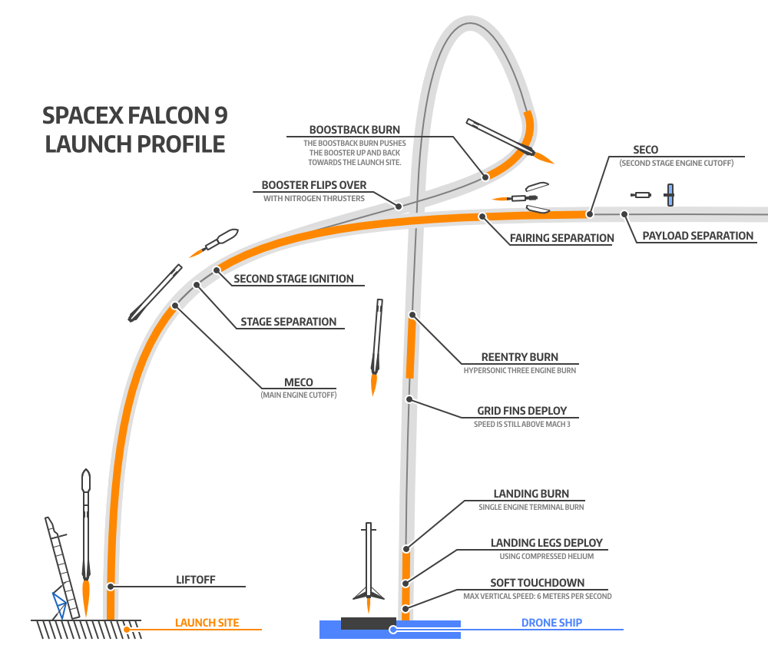

Slide 2
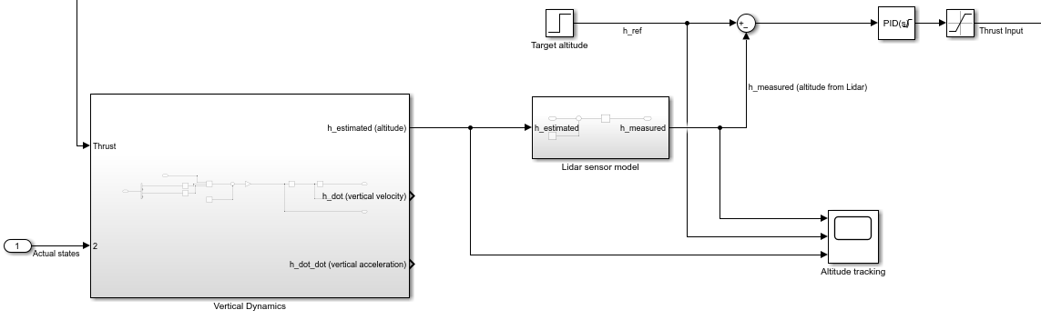

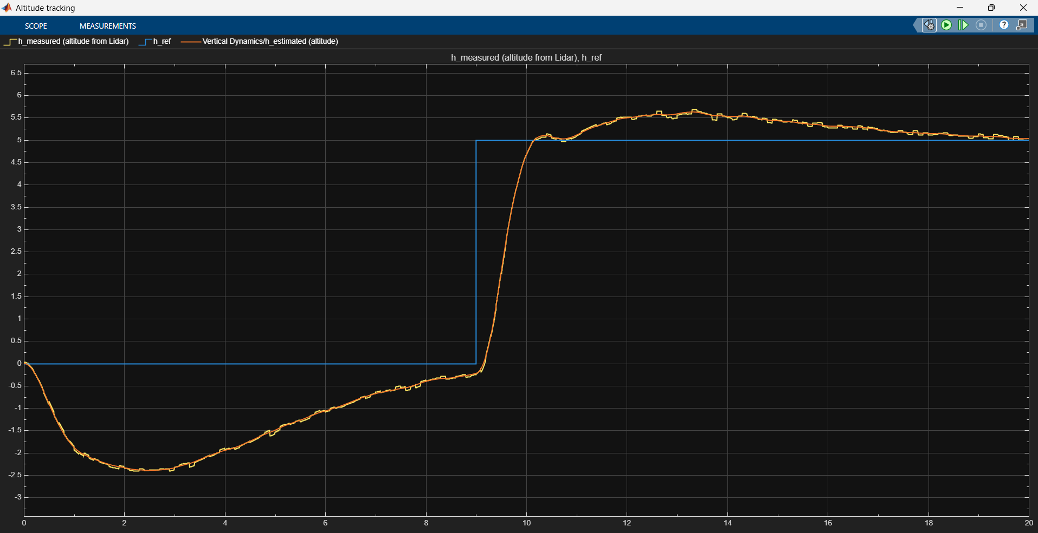
Height control
h_ref is set in a pre-established flight-plan.
h_error = h_ref – h_lidar(measured).
h_error→PID→Total_Thrust setting needed to hit the height set point.
h_max
h_ref commands 0 m, but since the ground is not included in the simulation model, then the Lidar start to measure loss of altitude as gravity acts on the rocket.
h_ref commands 5 meters at time = 9 seconds. PID acts to avoid overshoot and quickly converge to the command signal.
h_min

Slide 3
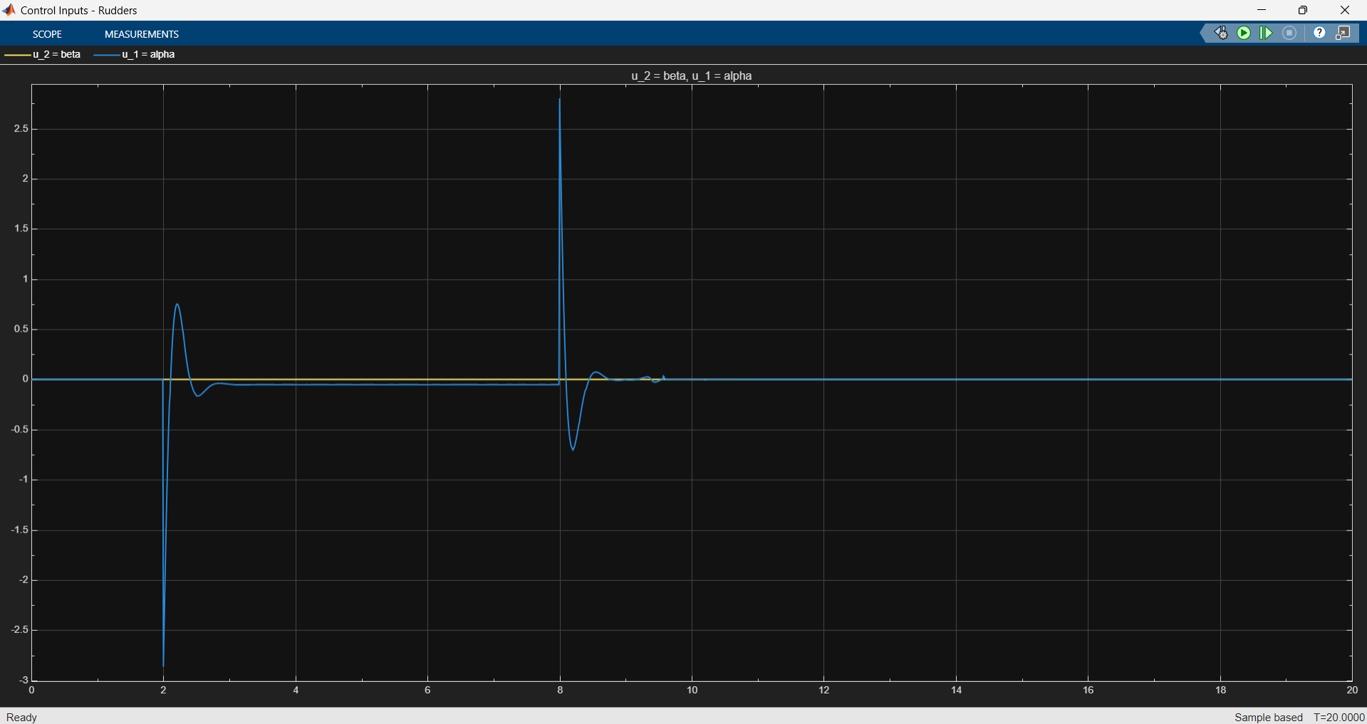
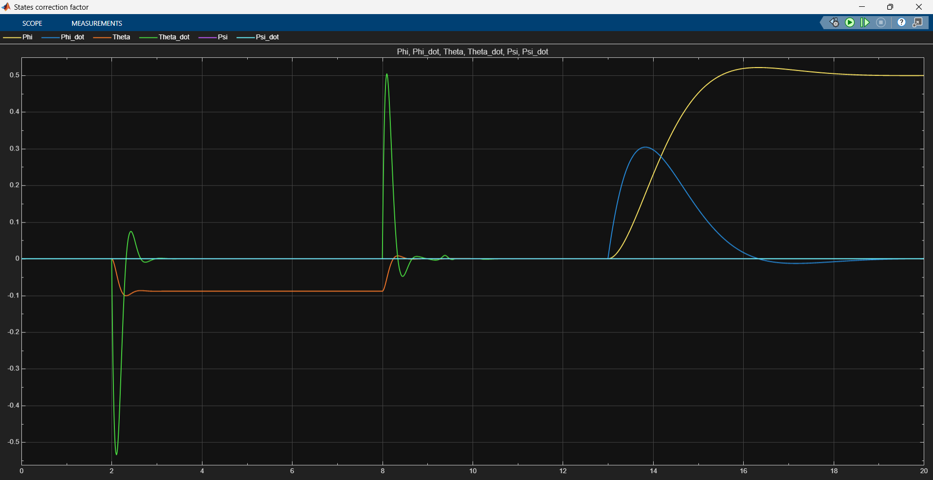
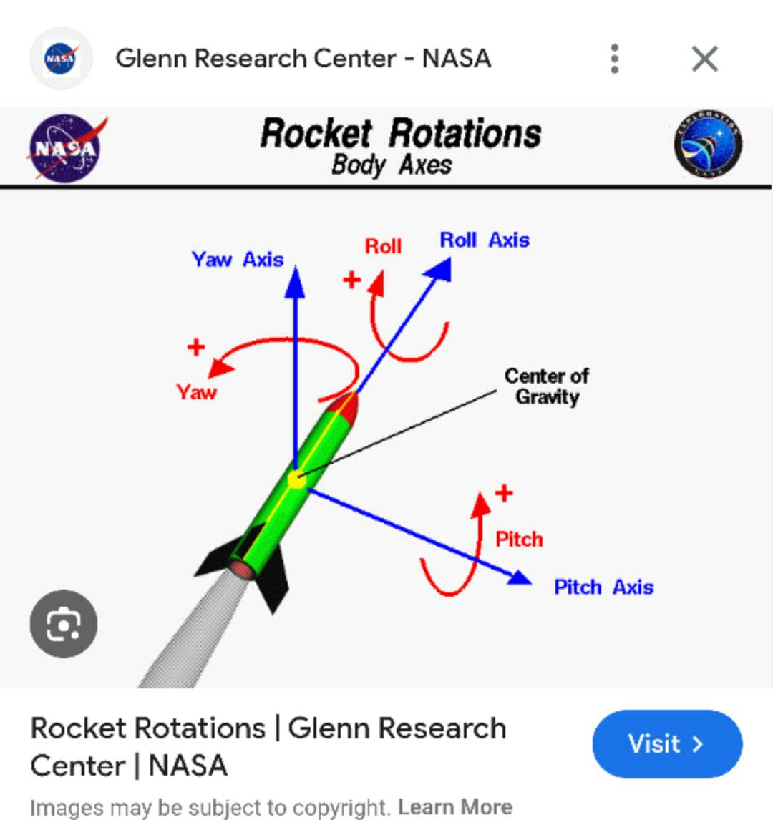
Thrust-LQR gain scheduling
LQR gain is calculated for different Thrust levels from T_min to T_max, the values are stored in a Lookup table. Any value in between is interpolated.
The LQR gain for any corresponding thrust setting then forces the state-space system inputs [RPM_propeller1, RPM_propeller2, pitch_rudder, yaw_rudder] to adjust according to the desired set points.
Simulated wind gust during time = 2 -8 seconds. Pitch states are affected, and alpha rudder inputs react to stabilize
A roll command is given at time = 13 seconds. Propellers react quickly to reduce roll, see next slide.

Slide 4
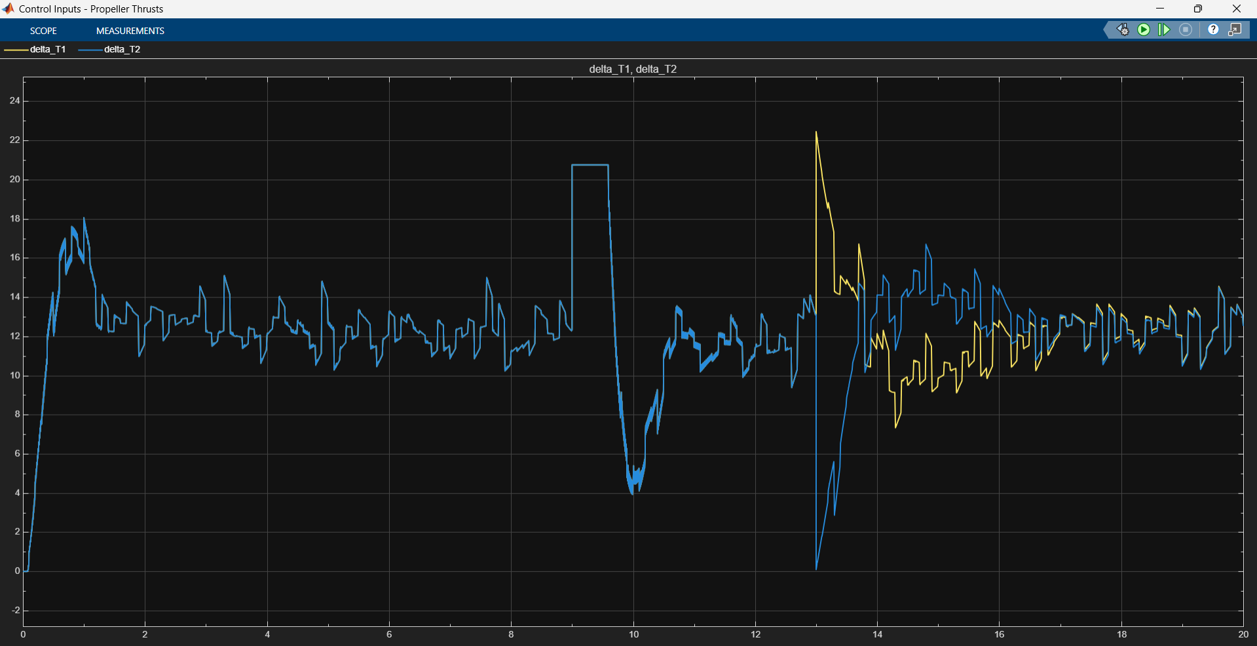
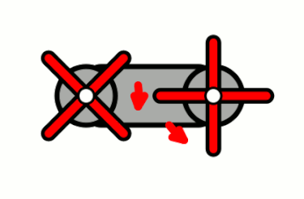
Roll-Pitch-Yaw control
The LQR strategy is aimed at reducing:
1. Unwanted roll (by manipulating the RPM differential between propellers.
2. Unwanted shifts from yaw or pitch set point =0 (upright position control modelled like an inverted pendulum).
Ultimately, roll, yaw, and pitch drifts are kept at a minimum to improve stability of the rocket during flight.
For the altitude = 5 m command, both propellers go to max thrust.
A roll command is given at time = 13 seconds. Propellers provide an RPM difference that compensates roll and also affects total thrust.
Tandem-rotor helicopters use counter-rotating rotors, with each cancelling out the other's torque.

